Slide 1
Business Automation Workflow by IBM
Business Process Management (BPM)
Digital and Technology
Artificial Intelligence And Robotics Solutions
Büşra AYAR
RPA Developer
Aizhan BAKIROVA
RPA Analyst
Gül ULUTAŞ
RPA Analyst

Slide 2




Business Process Management
BPM focuses on creating a consistent, automated process for routine operations and human interactions. It prevents time loss, reduces repetitive work and helps reduce operational costs of the business.
Business Process Management helps organizations move towards digital transformation and achieve corporate goals.

Slide 3
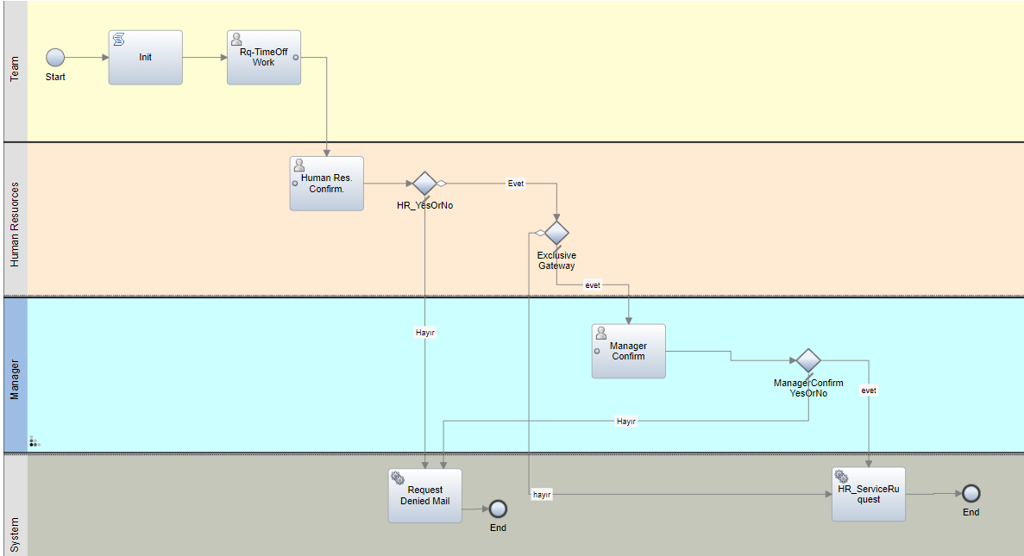
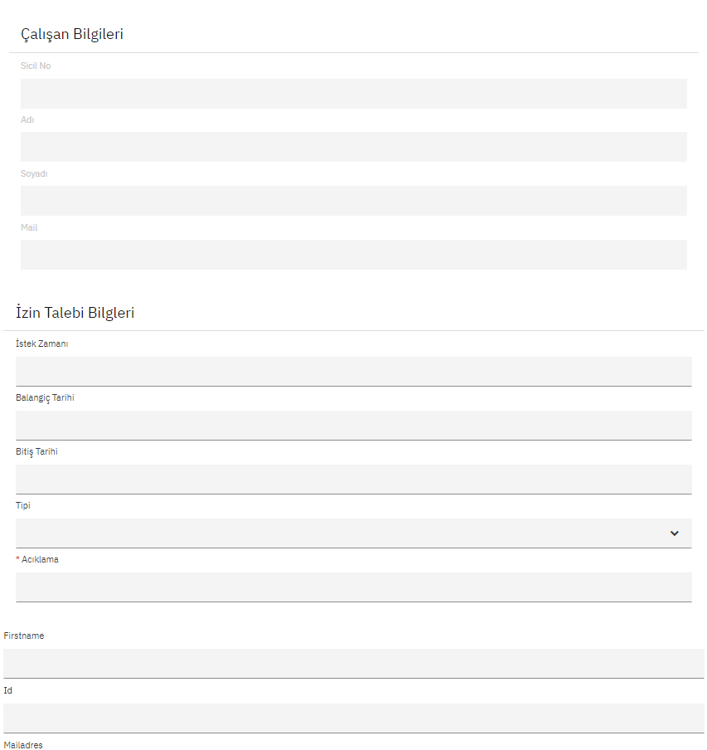
WorkFlow
Workflow is defined as a sequence of tasks that processes data through a specific path. The steps required to achieve the goal are shown. The steps in the process are interrelated.
If there are different departments, they are indicated in the flow. Mail notification, call web service, two-step confirmation, etc. All transactions are specified in the flow. (LDAP, SAP, RPA, 1C, func., business rules)

Slide 4
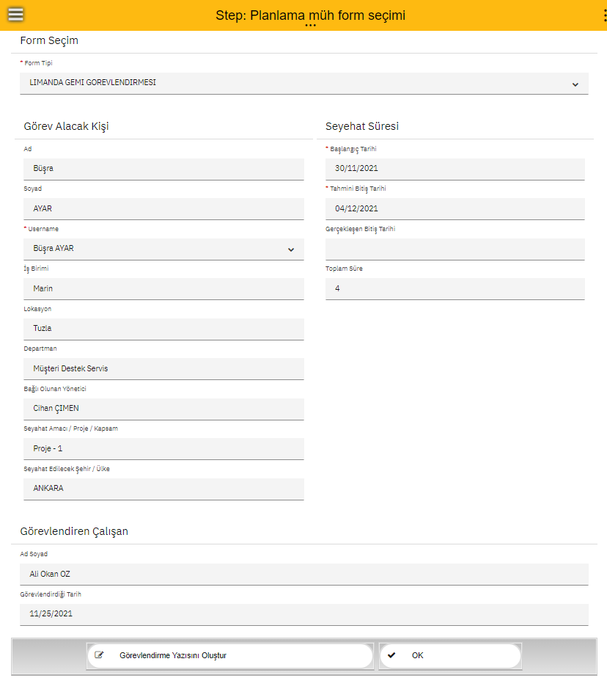
Forms (Screen)
If there is a need for shared screens in the example, it can create it as desired. In these forms, we can fill in the default fields and make calculations and save them as pdf or upload them to opentext.

Slide 5
Which Processes are Suitable for BPM ?
If workflows that require approval between different departments are required, these workflows can vary:
In processes that require manual approval flow can be used to digitize approval flow
In processes that have business rules (permission process)
In manual processes where are the hard copy using
Parallel flow or serial (sequential) approval flow needs if multiple people, managers, and departments are involved in the flow
If there are manual form filling needs and their digitization (automatic filling of the specified fields in the form)
If there is a need for integration such as 1C , SAP, accounting register
If there is a need for reporting for fast progress and archiving of all forms

Slide 6
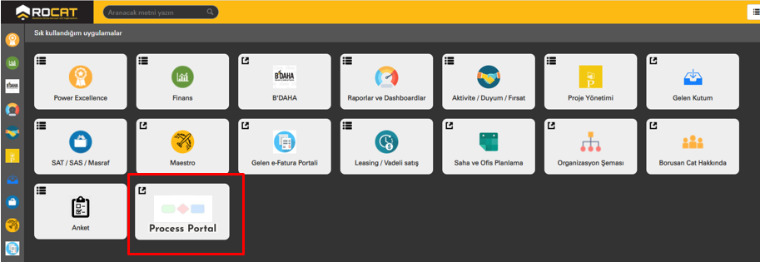
How to Process Begin ?
Go to the Rocat page.
Login is made by clicking Process Portal.

Slide 7
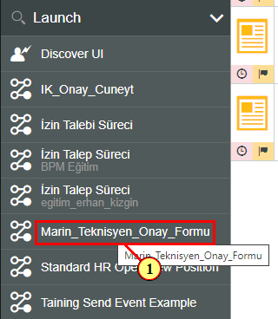
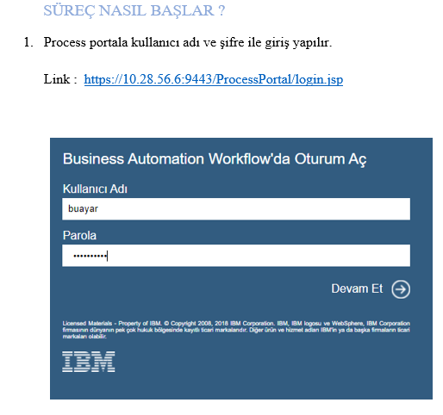
Login to the portal with username and password.
If a process has been assigned to you, a login link will be sent by e-mail.
These are responsive forms. In other words, the phone is shaped in accordance with the tablet computer.
If you will start a process : BPM processes are opened to authorized people. The process you want to start is started by clicking.

Slide 8
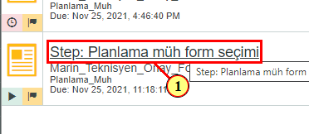
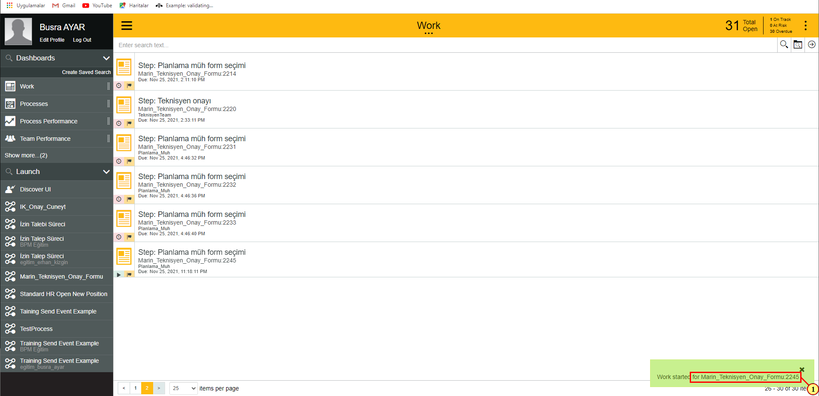
When the process starts, a task is assigned to the relevant person and an e-mail is sent to that person. In addition, assigned tasks can be viewed on the same screen.

Slide 9
An example BPM process :
In this process, our aim is to digitize marine technician approval forms.
The assignment form created for the technician using BPM technology is sent to the approval of the relevant people in order.
If any of the relevant people do not approve, the service operations engineer revises the process and restarts it.
After all approvals are given, the assignment letter created will be stored as pdf in the specified folder.
There are 3 different types of forms;
2 forms type, after the approval of the director, the 1 form type assignment form is finalized after the approval of the manager.
Any rule can be added to the flow.

Slide 10
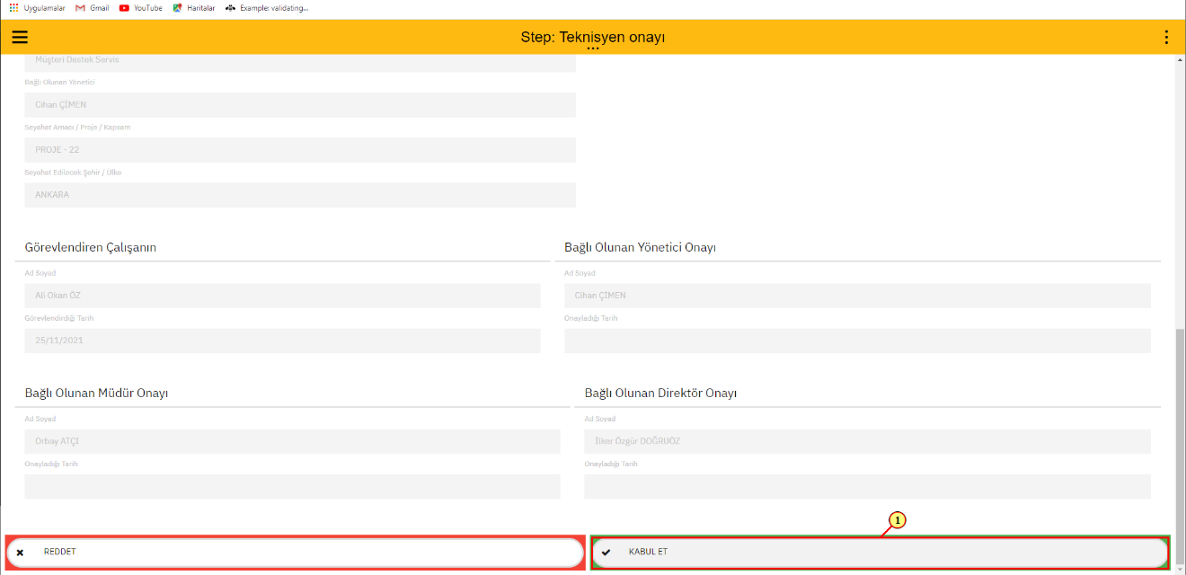
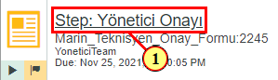
A notification appears on the screen of the person who goes for his/her approval and is sent to the Mail.

Slide 11
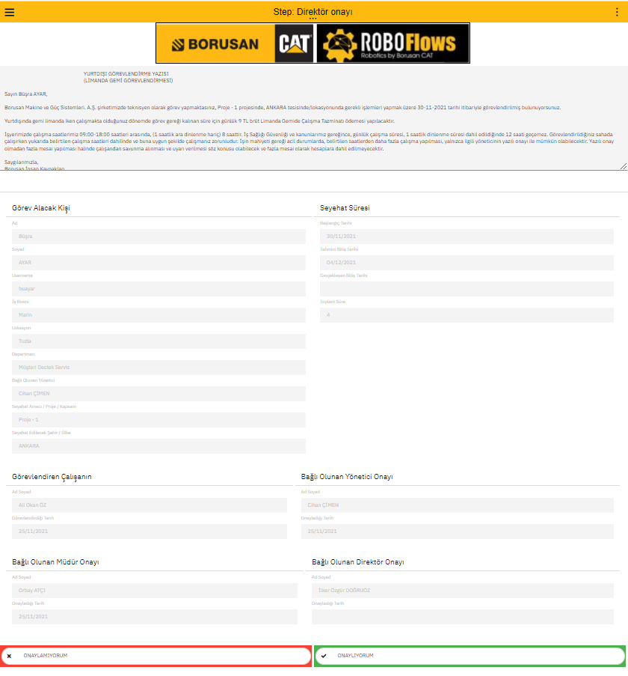
Flow continues or ends depending on whether it accepts or not.

Slide 12
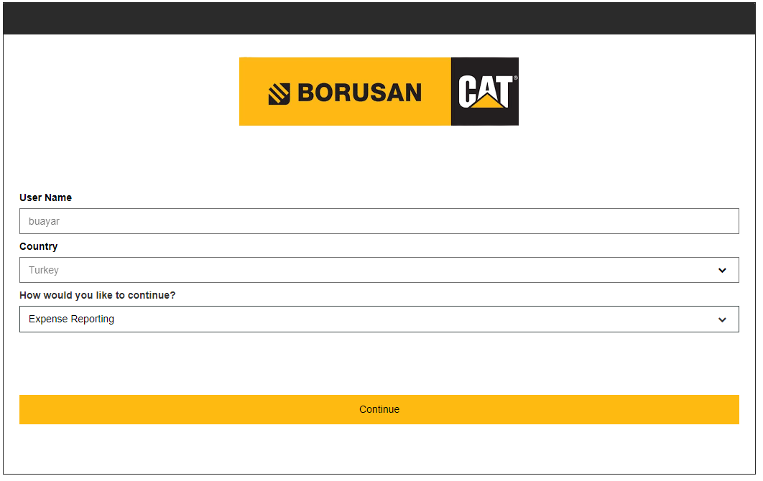
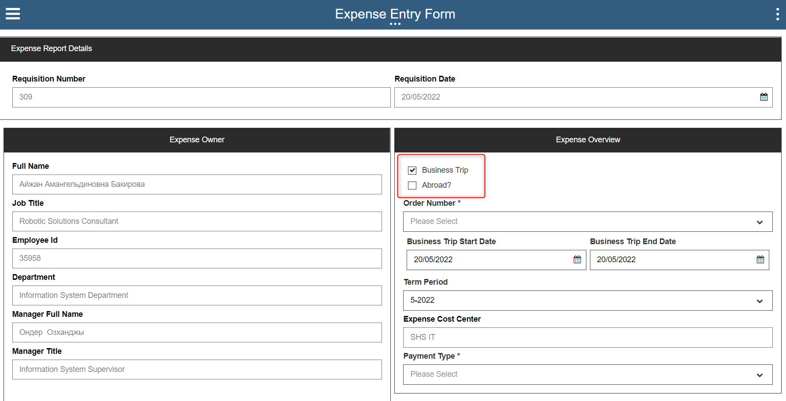
Another example is the Expense portal process, which will be used in all countries.
We have completed the final tests in Kazakhstan. You will have automatic login from Portales LDAP.

Slide 13
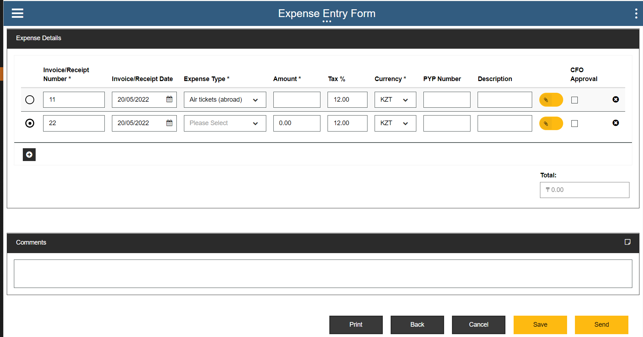
You can request an expense from this screen.
When the required fields are filled in the form, the process goes to the approval step and the OpenText document is saved after all approvals are received.

Slide 14
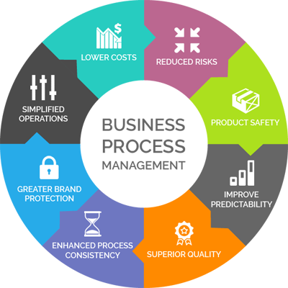
Why should we use BMP?
Bringing a process under control
Facilitate a process improvement
Monitors performance
Facilitate communication between IT and the business partner
To enable activity and competency tracking,
To standardize a process

Slide 15
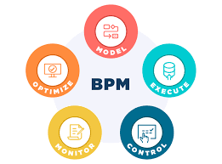
In summary, our aim in BPM developments is to digitize manually proceeding processes.
With the RPA system, these operations can also be done with a robot, but BPM and RPA have a very important difference.
RPA processes are rule-based and cannot be done with human intervention. However, in BPM processes, you can direct the process in your own way.
In addition, BPM can offer you screens or forms with the view you want.

Slide 16
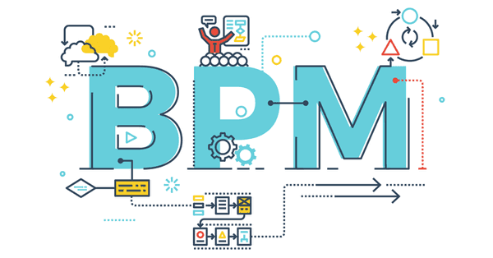
Teşekkürler..
Digital and Technology
Artificial Intelligence And Robotics Solutions

